Slide 2
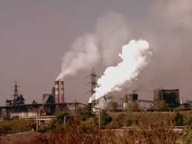
The Environment in Ukraine Challenged and opportunities

Slide 3
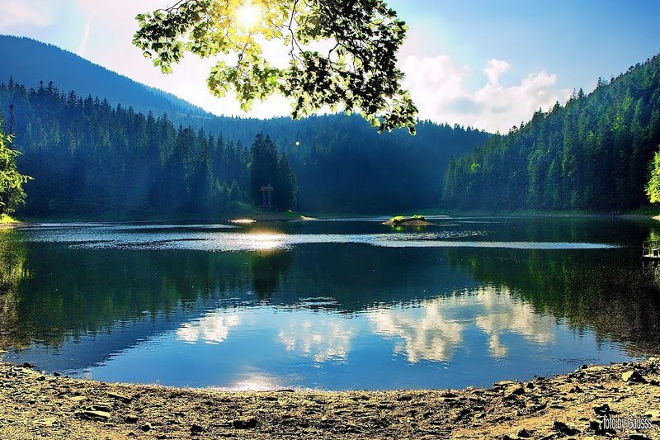
Natural uniqueness of Ukraine
8,7% from world amount of black soil
67,7% of Ukrainian soil is valuable black soil
Unique mountain, steppe and marine natural systems
Recreational possibilities
5 % of the world stock of natural resources

Slide 4
Global environmental degradation
a child dies every 8 second because of contaminated water
14 billion of garbage are dumped into the ocean every year
we have already lost 27% of coral reefs
breathing the air in Mumbai (India) for 1 day is equal to smoking 100 cigarettes.
the Earth has already lost 80% of its forests
we are using up 50% more natural resources than the Earth can provide

Slide 5
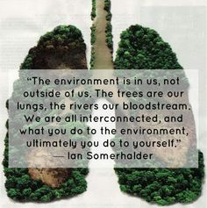
Ukraine: important facts
In Ukraine, every 15 minutes 5 people (including 3 children) die because of poor state of the environment (WHO)
The average life expectancy is 71,2 years (10-15 years shorter than in European countries)

Slide 6
Ukraine: important facts
Environment – it’s about life and there could be no compromise about it
28% of Ukrainian population breath the air that is dangerous for health
20% of all waste water is dumped into the environment without any purification
40% of ploughlands are degraded

Slide 7
Overarching problems in the field of environment
Disregard for sustainable development principles
Slow pace of AA implementation
Ineffective environmental control
Lack of adequate legal responsibility for environmental crimes
Low environmental awareness and culture

Slide 8
Disregard for sustainable development principles
2020 Strategy of Sustainable Development of Ukraine – underestimation of environmental component
Lack of cost-benefit analysis for the environment

Slide 9
Examples of disregard for SDGs
Small hydro power plants
0,15% of energy production
“Green” tariff

Slide 10
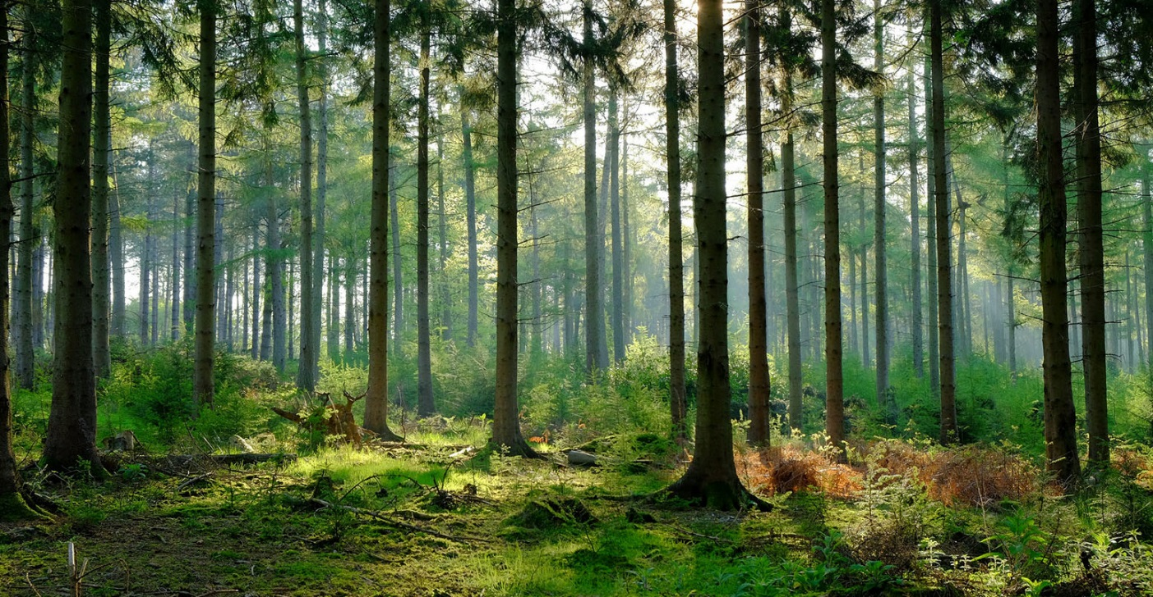
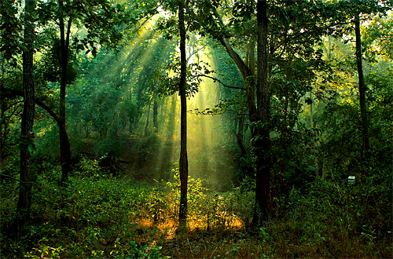
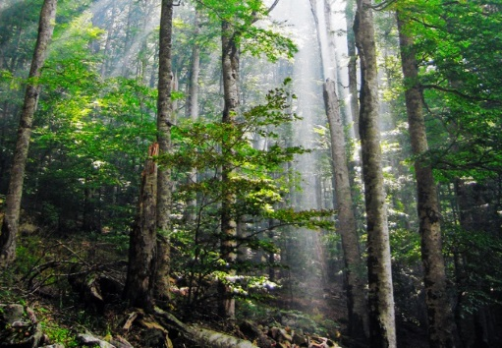
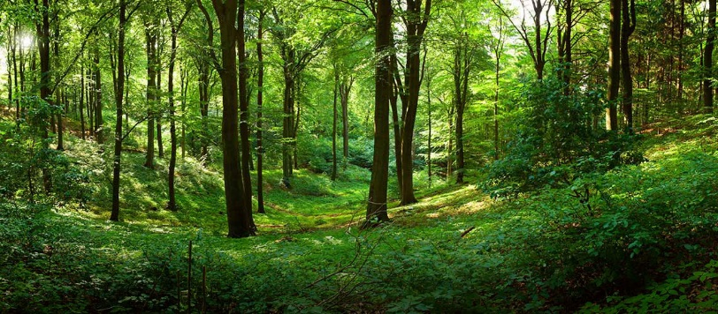
Forest biodiversity loss

Slide 11
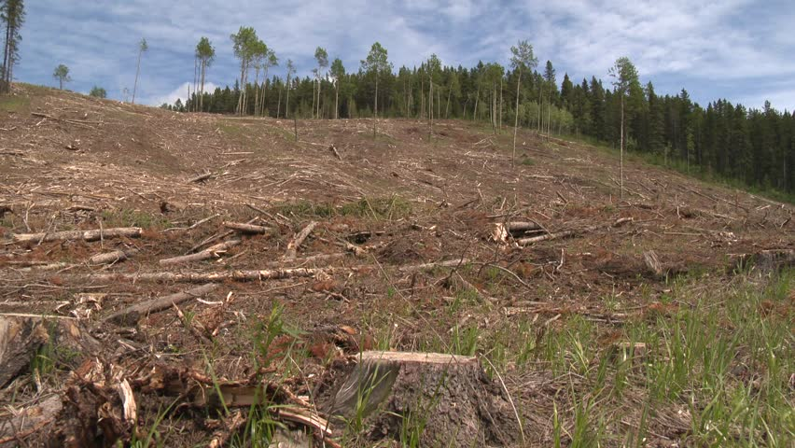
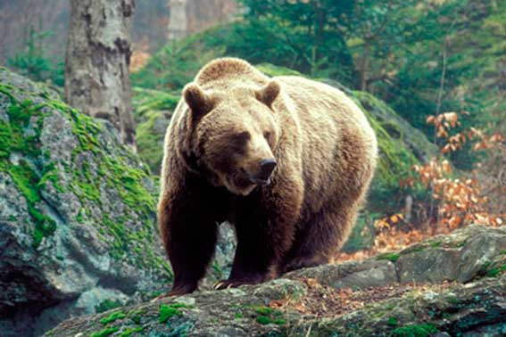
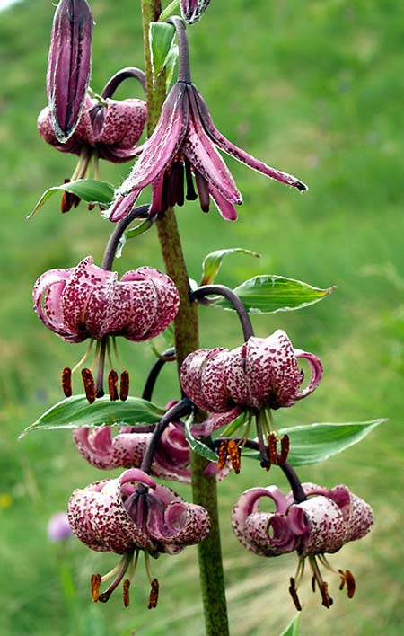
Every 5th animal species and 8th plant species of the Red Data Book of Ukraine die out as a result of forest logging

Slide 12
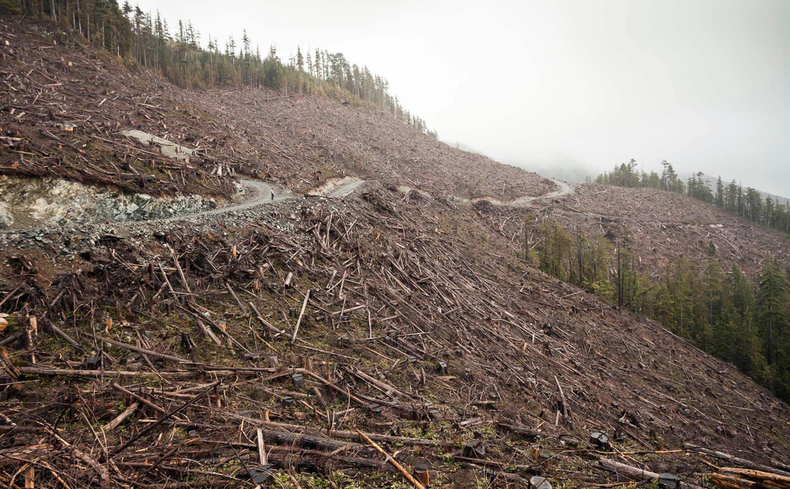
Contradictory legislative norms and rules of forest management
Lack of national strategy of forest management including policy on invasive species
Lack of state electronic database (cadaster) of forests
Destruction of 1 ha of forests causes the damage exceeding the economic benefit by 9-25 times

Slide 13
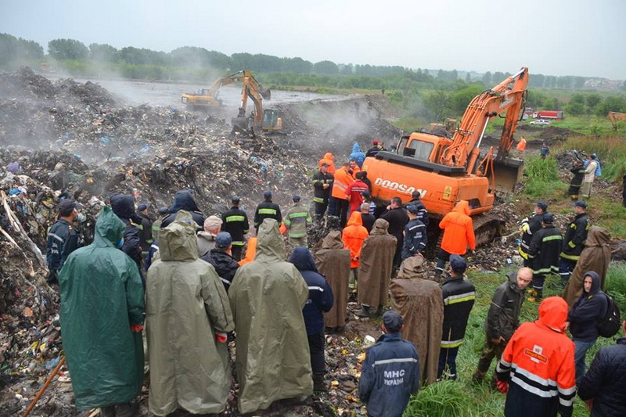
Waste
In Ukraine - 95% waste landfilled
In the EU countries – 2-5 % landfilled.

Slide 14
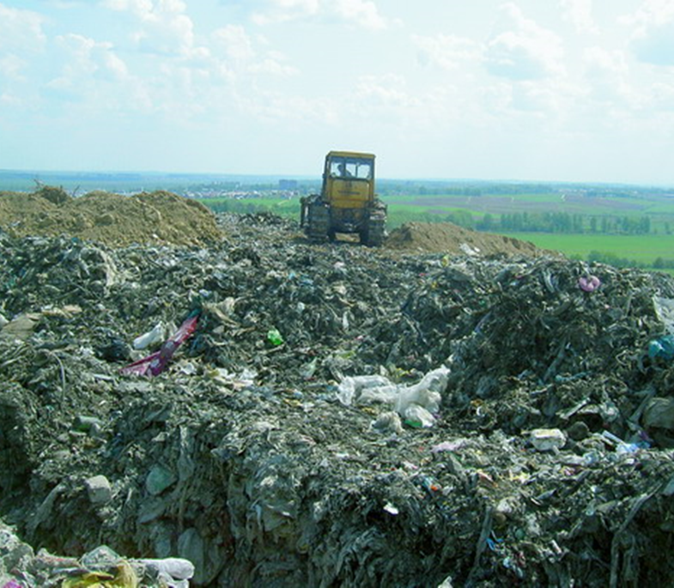
Waste
Adaptation of European legislation on waste
. Application of modern technologies
Conceptual shift to treating waste as resource
Landfilling vs. reuse
Lack of modern technologies
Non-compliance with waste legislation

Slide 15
Ineffective environmental control
Limited capacity of controlling bodies to perform operational inspections
Formal rather than actual inspections (documents, not the state of water, air, soil)
Control for punishment, not for prevention
Controlling function dispersed among many agencies
No supervision and no responsibility for ineffective control

Slide 16
Lack of adequate legal responsibility for environmental crimes
Environmental crimes are not covered by the criminal legislation
Punishment for environmental violations is ridiculously small and rarely actually executed
Ineffective injunction mechanism
Outdated system of calculating damage to the environment
Ineffective system of compensation for environmental damage

Slide 17
Low environmental awareness and culture
67% of Ukrainian do not know what «environmental rights» mean
54% of respondents are not active in protection of their environmental rights and will not participate in environmental movements

Slide 18
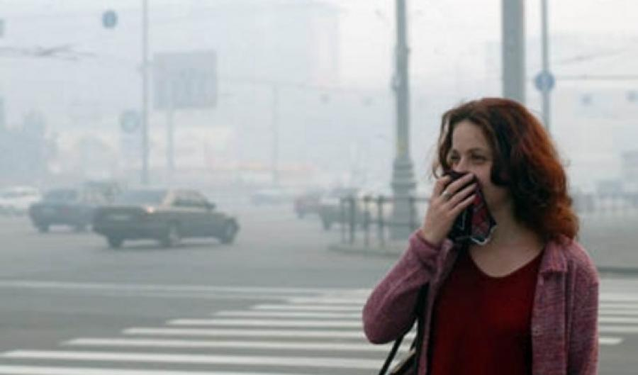
Polluted air in residential areas
Decreased green areas
Ineffective transport system
Energy inefficient industry
Incompliance of business entitites
with legislation on ambient air (heavy
industry, agriculture)

Slide 19
Air, water and soil pollution with pesticides
use of toxic pesticides that are banned in Europe (Acetochlor)
no control over quantities of pesticide spraying and types of pesticide used
devastating harm to human health, contamination of soil and water, destruction of whole ecosystems

Slide 20
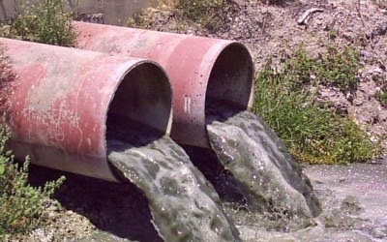
Water pollution
Causes:
-Lack of water quality monitoring
-Ineffective waste water
treatment
-Lack of control and
accountability

Slide 21
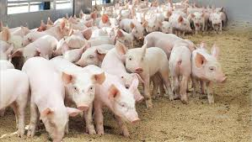
Environmental pollution by animal raising farms
Non-compliance with environmental legislation (sanitary zones, farm capacity, emission norms)
Pollution of plough lands
Contamination of well water
Excessive use of water causing water deficit in local communities
Strong smell causing allergies and other health disorders
Methane and ammonium emissions

Slide 22
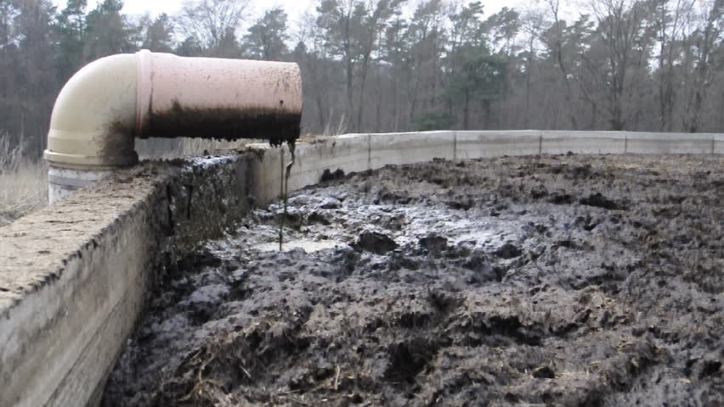
Animal raising farms
1. Ineffective state control and small fines for violations.
2. Non-transparency of investment projects, negligence of community interests
3. Outdated norms for manure processing and disposal.
Solutions:
.1. Reform of the system of environmental control and responsibility
2. Application of SEA and EIA mechanisms
3. Application of European standards of animal waste management

Slide 23
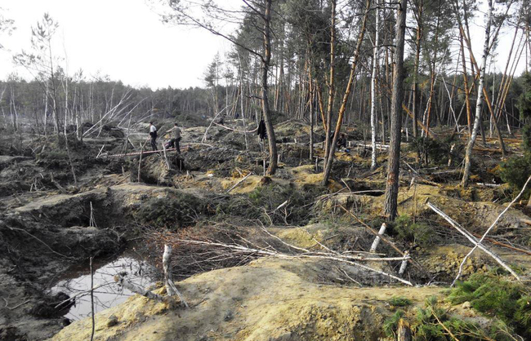
ILLEGAL AMBER EXTRACTION

Slide 24
Natural protected areas
EU countries – on average 18% of territory
Ukraine - 6,8%
In 2014, the Strategy of Regional Development set the goal of 17% by 2020
2015 – 3,5 % of the planned increase
2016 – 1,3% of the planned increase

Slide 25
Development of Emerald network in Ukraine
Expert work, field studies, desk research
Determination of new territories. Implementation of the idea of preservation of natural complexes of river valleys.
Development of cartographic materials
Filling in data templates
Cooperation on the national level. Participation in international biological and geographic seminars. Environmental awareness-raising

Slide 26
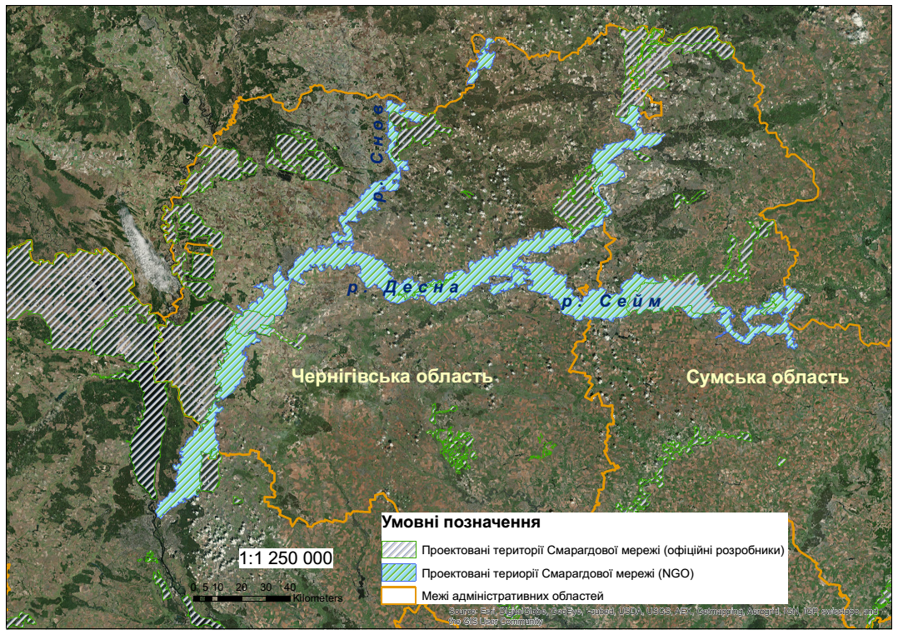

Slide 27
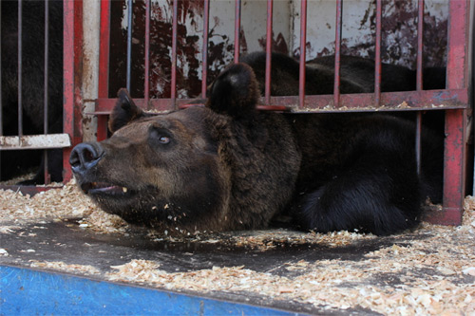
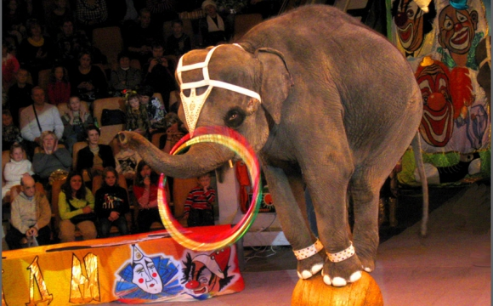
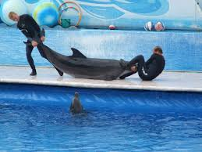
Violation of rights of wild animals
Illegal capture and transportation of exotic animals
Inadequate legal regulation of treatment of wild animals
Low environmental and legal awareness and culture
Solutions:
Ban on using animals for commercial purposes, in entertainment shows and animal testing
Creation of rehabilitation center
Effective control over animals rights

Slide 28
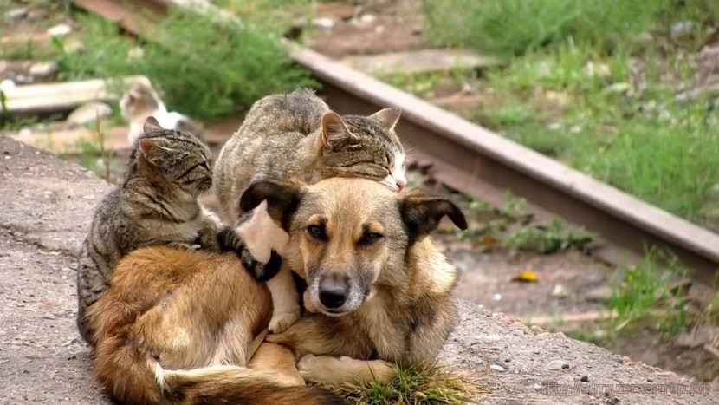
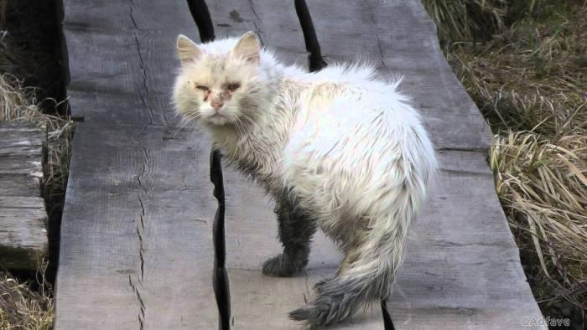
Cruelty to domestic and homeless animals
Lack of obligatory identification of animals
Irresponsible owners
Faults of civil law regarding regulation of animal ownership issues
Solutions:
Bridging legislative gaps in the field of animal protection
Launching animal shelters, animal identification and sterilization centers
Establishing the effective system of control over animal rights

Slide 29
Climate change as cross-cutting environmental issue
Deforestation
Fossil fuel burning
Energy inefficient industry
Industrial emissions
Inefficient transport
Animal farming
Ineffective waste management
Biodiversity loss
Solutions:
transition to renewable energy
- radical reduction of GHG emissions
use of organic farming and reduction of livestock
forest and ecosystem conservation
changes in the transportation system
Changes in consumeristic minds of Ukrainians

Slide 30
The way to move forward
AA implementation
29 environmental directives and regulations
-environmental governance and integration of environment into other policy areas
air quality
waste and resource management
water quality and water resource management
nature protection
genetically modified organisms
Only 2 directives partially implemented

Slide 31
Introduction of EIA – environmental breakthrough
The filter mechanism for environmentally hazardous projects
Effective preventive tool (mandatory EIA report)
Transparent procedure (online database of EIA conclusions)
Effective procedure of public participation
The tool of ensuring sustainable development
Ukraine is back in compliance with the Aarhus Convention

Slide 32
Strategic Environmental Assessment (SEA)
The tool of ensuring integration of environmental component into all policy fields – environmental lense
SEA Protocol ratified by Ukraine
Draft law on SEA on the final stage of adoption
Enforcement of Ukraine’s obligations with the SEA Protocol (EPL’s case)

Slide 33
Ukraine’s international obligations on climate change
Ukraine is back in compliance with the Kyoto Protocol
The draft law “On Protection of the Ozone Layer”
The Paris Agreement - Ukraine joined in solidarity to promote international commitment to decrease GHGs emissions
Membership in the European Energy Community as a tool of increasing the share of renewable energy and decreasing emissions

Slide 34
Adaptation of Water Framework Directive in Ukraine
The leader in implementation of AA
The framework law adopted introducing the basin approach to water management
Classification of water objects according to ecological and chemical status
Indicators of good water quality
The regulatory base for implementation of the legislation has been developed
Next step – enforcement

Slide 35
Waste policy and legislation
National Waste Strategy – conceptual shift from landfilling to waste prevention and reuse
Development of new legislation (framework waste lawe, legislation on packaging, plastic waste, WEEE)
Switch to efficient technologies

Slide 36
Conclusions
Systematic changes are needed in the fields of environmental control, responsibility for environmental violations
It is vital to raise environmental awareness and culture of Ukrainians
Ukraine should intensify its efforts in implementation of the EU-Ukraine Association Agreement and bringing Ukrainian legislation into compliance with European norms with particular focus on enactment and enforcement of new legislation on environmental impact assessment (EIA) and strategic environmental assessment (SEA)
Active engagement of civil society – driving force of changes

