Slide 1
Modern digital technologies and e-justice practice in Ukrainian courts
Olha Melen-Zabramna, attorney, EPL (Ukraine) and Ecoforum

Slide 2
Sole judicial information-telecommunication system
Was launched by the Law in 2021
Consists of informational and tele-communicational modules, allowing automatization of judicial procedures, namely casefiles management, automatic judges distribution, exchange of documents between the court and the participants to the dispute, recording of judicial procedure and video-conferencing, provision of informational aid to judges etc.
Modules:
Web-portal «Judicial power of Ukraine»;
State registry of judicial decisions;
Official electronic address (E-CABINET);
One contact-center of judicial system;
Automatic judges distribution;
Electronic court (e-court);
Court statistics.
Notes:
Містобудівна документація місцевого рівнів вся підлягає згідно закону про РМД..

Slide 3
System E-court
Allows to use electronic channels (e-mail) so send documents to courts and to receive documents from courts , to exchange documents between participants to judicial proceedings
It allows access to electronic case files
Email addresses of attorneys, state bodies, bodies of local self-government, other parties have to be registered there to allow communication through e-court system
Access to e-court is via email and with certified electronic signature

Slide 4
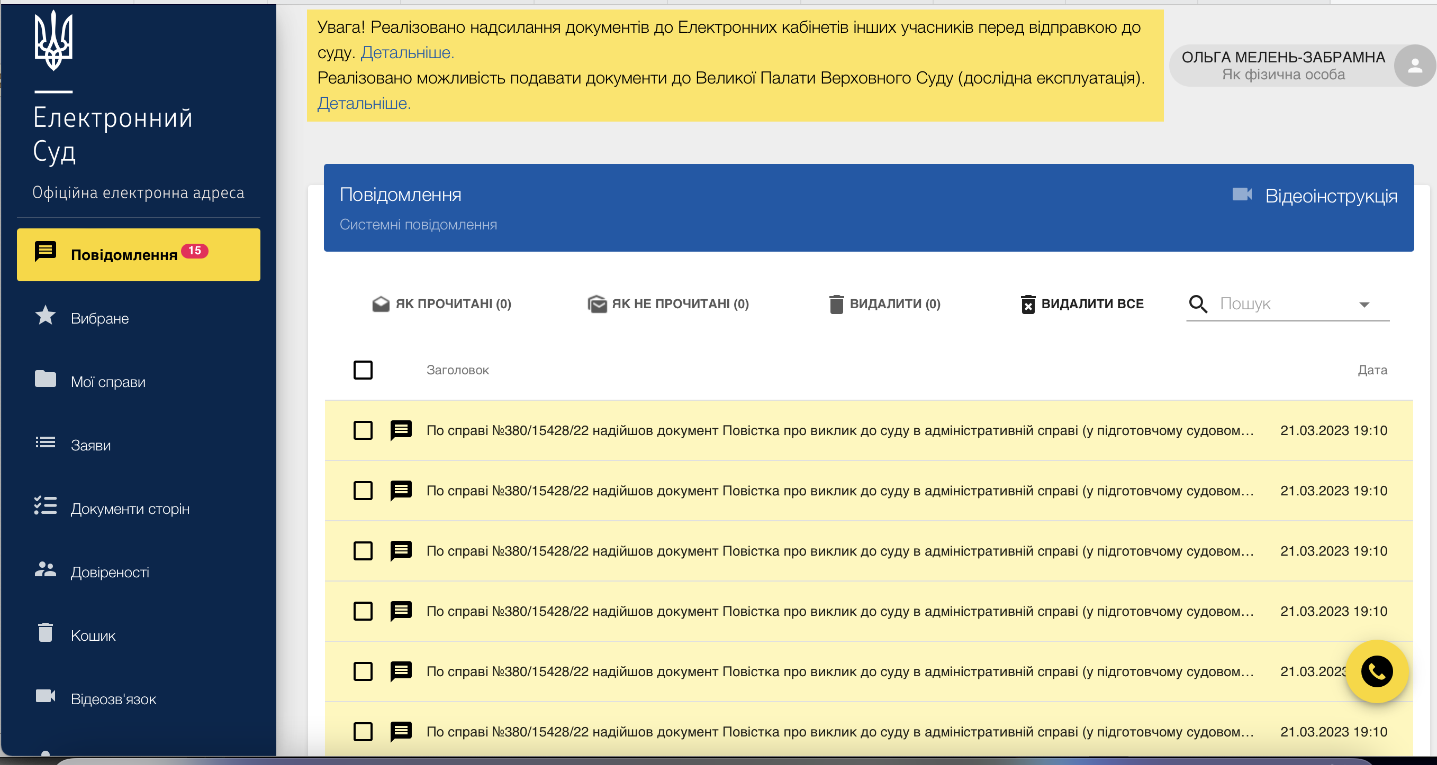
Notes:
Зміни до ДДП підлягають СЕО, якщо вони будуть мати впливна довкілля, якщо не будуть – то МОЗ, Міндовкілля або місцеві органи самі приймають рішення щодо проведення СЕО. Це рішення про непроведення має бути оприлюднено.

Slide 5
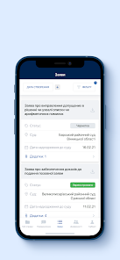
E-court mobile application
Allows to follow-up the case progress, push up notifications on new messages in electronic cabinet
Allows access to procedural documents, sent by court or by parties
Allows viewing procedural documents created by user in electronic cabinet
Allows viewing and annulling issued power of attorney and orders
Limitations – downloading and sending files to court is not possible

Slide 6
Court case of Rokoban LTD.
2 court cases:
Local municipality v. Ministry of Environment and Rokoban LTD, local LNGO as third party to a dispute concerning challenging of EIA decision
Local municipality and Prosecutor’s Office .v. Ministry of Environment and Rokoban LTD., local NGO as third party to a dispute challenging license for hazardous waste management
EPL attorney represented local NGO in court, participated via online portal

Slide 7
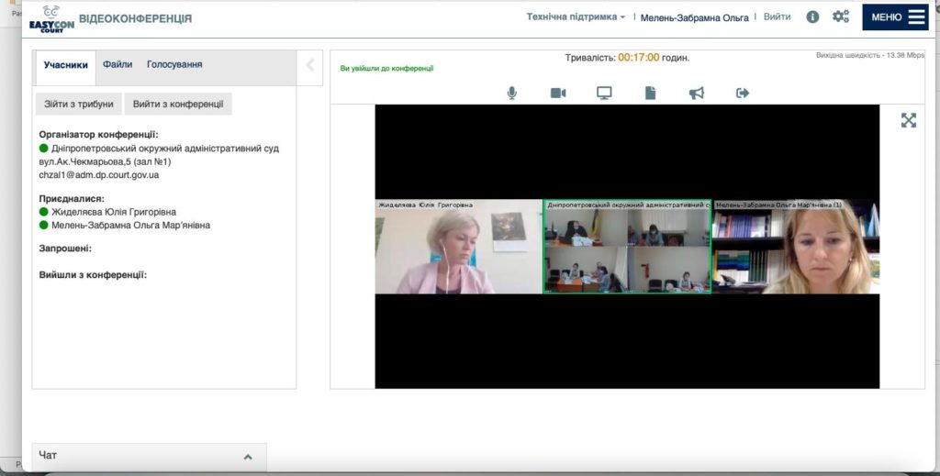
Court case: Municipality v.Rokoban LTD

Slide 8
Data bases of court decisions
https://lpd.juscourt.com/ - legal positions of the Supreme Court
https://reyestr.court.gov.ua – online data base of court decisions
https://court.opendatabot.ua/#/ - online service of court decisions “Granny”
https://conp.com.ua/ - analytical tool for search and visualization of court decisions “Court in the palm”;
https://verdictum.ligazakon.net/analysis - search and analysis of court decisions “Verdictum”

Slide 9
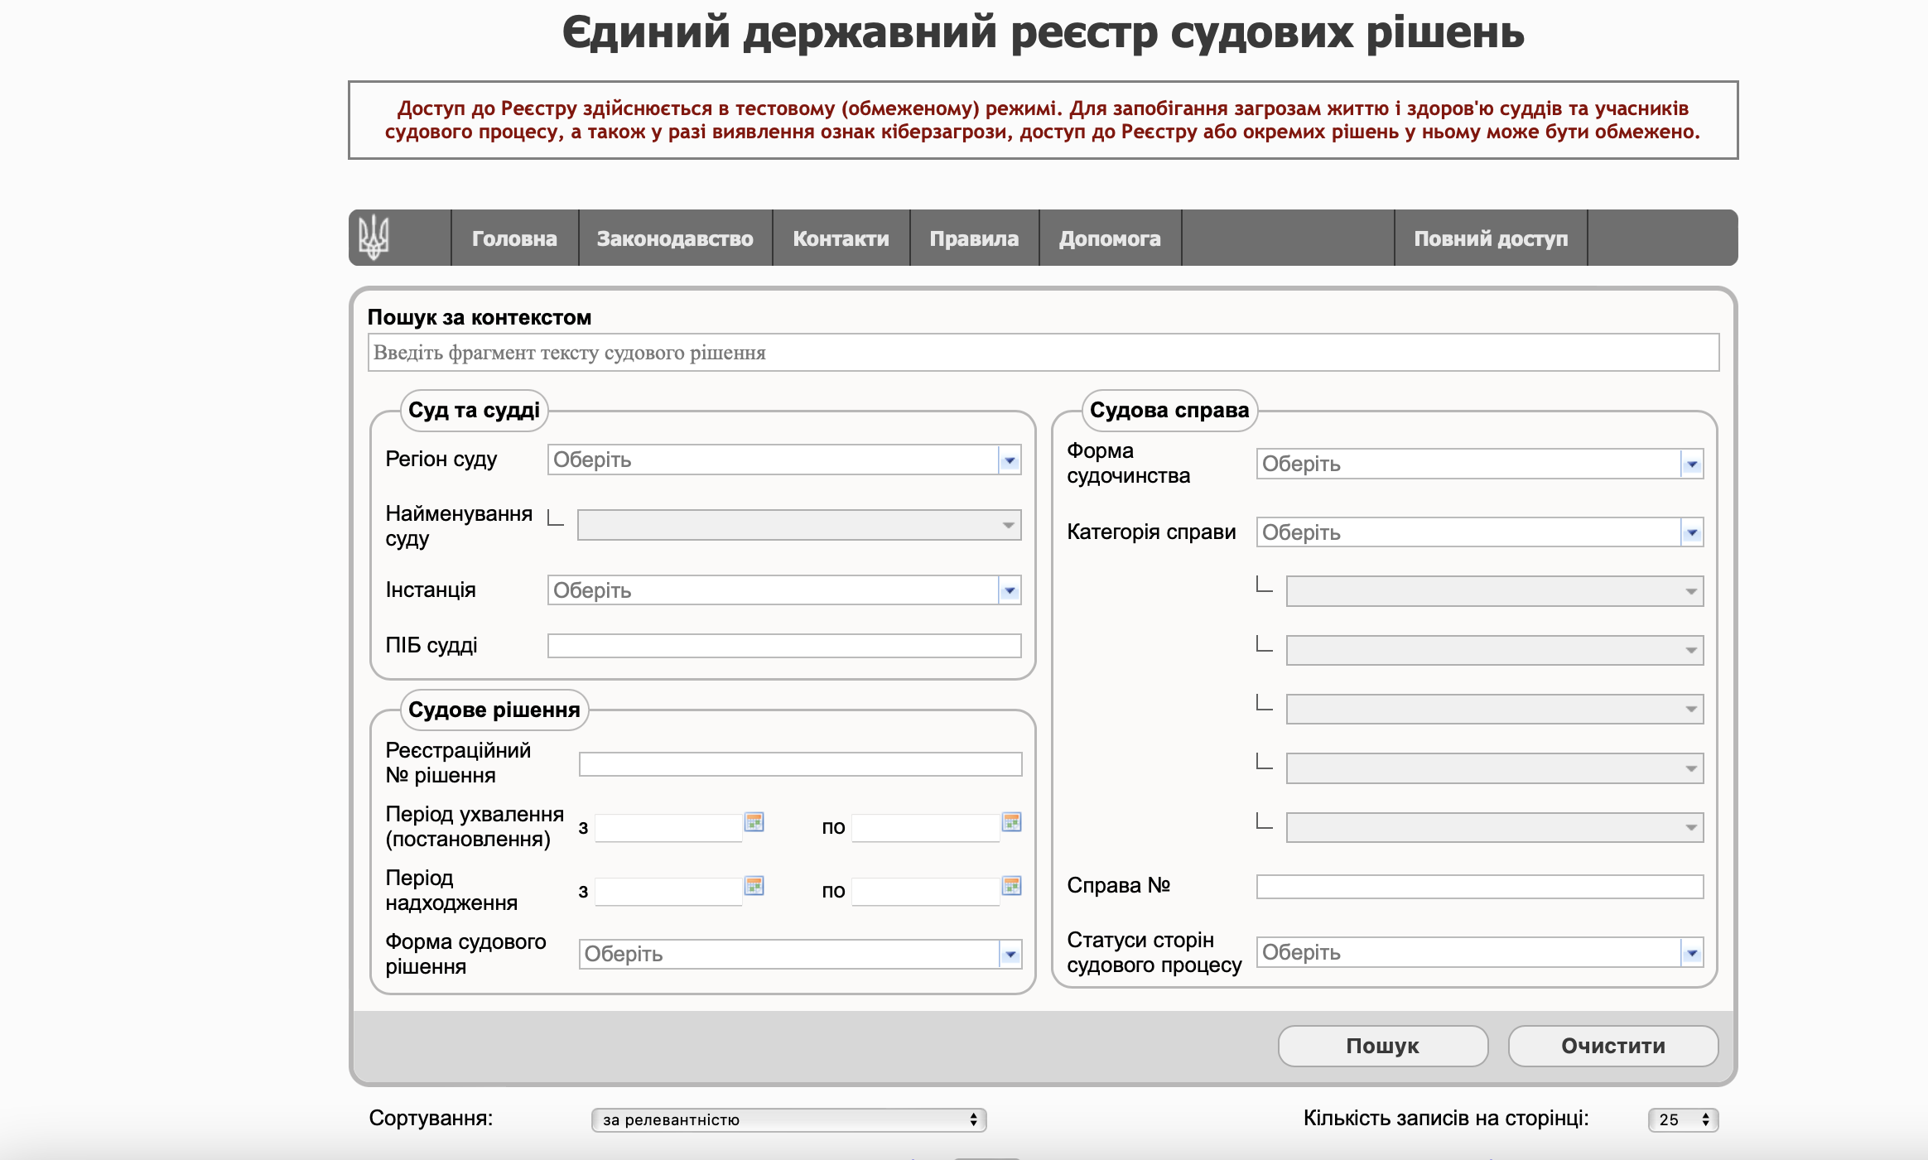

Slide 10
.

Slide 11
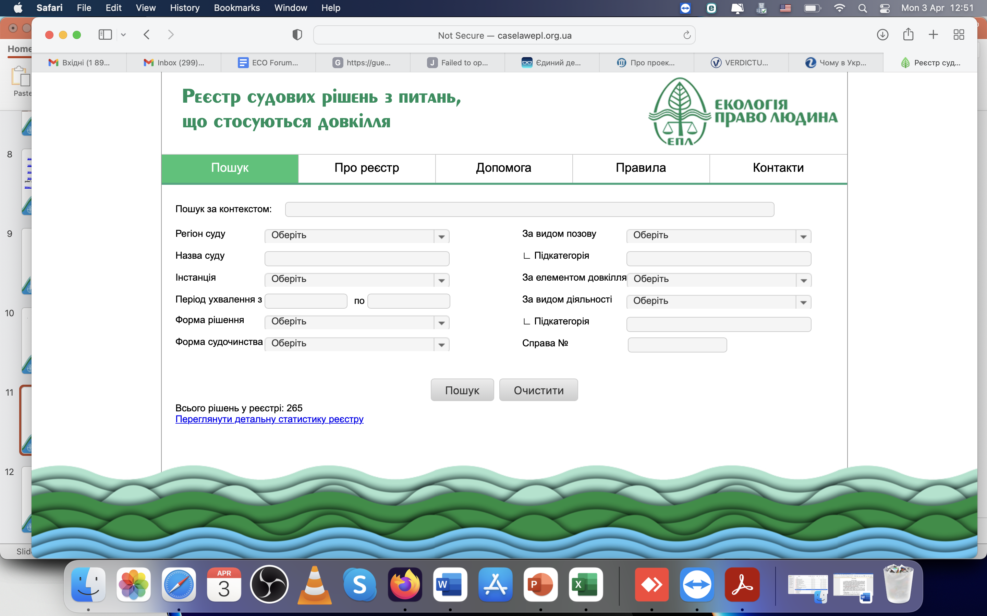

Slide 12
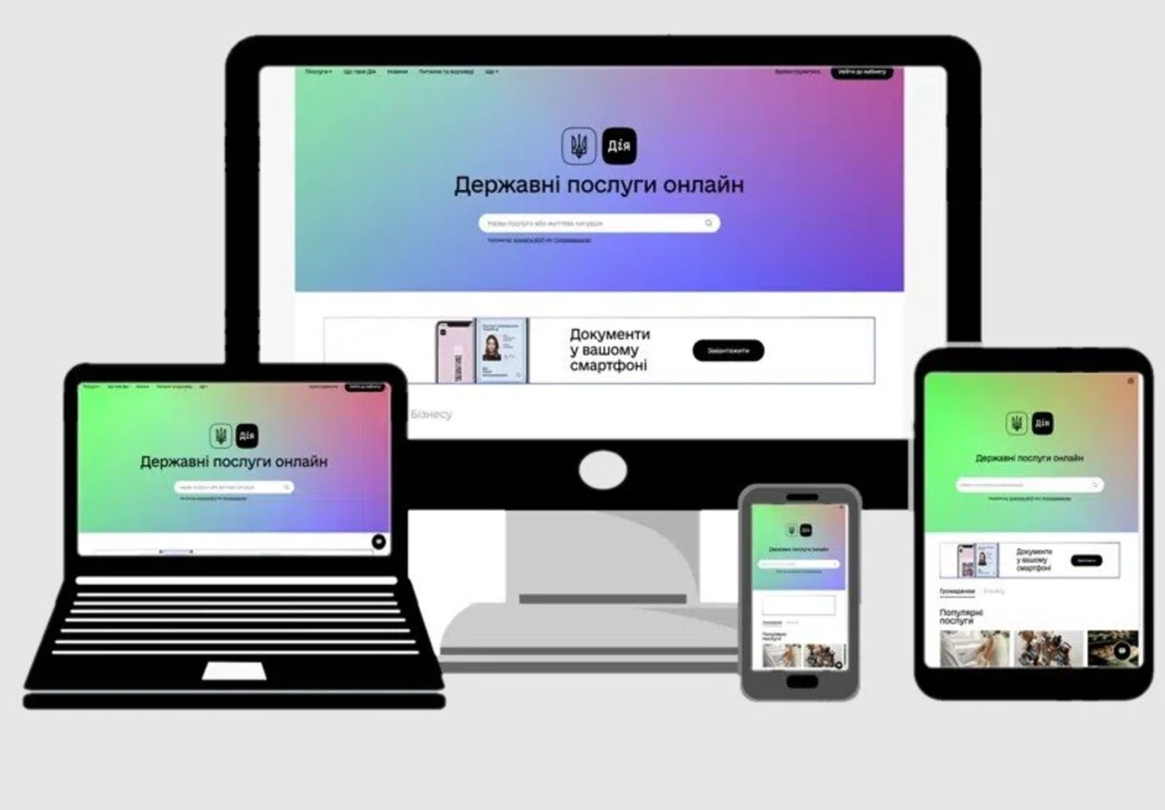
Thank you for your attention!!

